Slide 1
Capstone Project-1
Play store Analysis Sai Chaitanya Sonu Priyatham Kasturi Devoju Kaveri Devoju

Slide 2
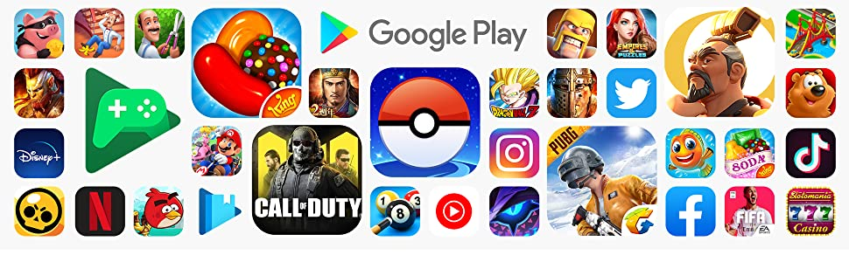
Analyzing the Google Play store Apps

Slide 3
The google Play Store started life as the “Android Market’ in the year 2008.It’s main purpose to serve the user with numerous applications and games, As of todays technology is escalating day by day the games are also gaining huge attention. In the earlier stage of the Play Store it was too basic, it didn’t support paid apps and games until 2009. However, as the Android Platform grew, so did the Android Market. By 2012, it featured over 450,000 Android Apps and Games

Slide 4
The main Purpose of our project was to Analyze the information on Apps in the Play Store in order to discover key factors responsible for app engagement and success. We gathered information about 11000 apps with several categories in the Playstore. We mostly focused on the most installed categories and also compared them with free and paid ones. Cleaning of the data was done by removing the null values and detecting the number of outliers which helped to keep the data Non Redundant

Slide 5
Points to Discuss on: > Data Cleaning and Detecting Outliers > Data Visualization > Category vs Reviews > Category vs Installs > Category vs Price > Paid vs Free Apps > Free vs Paid Apps > Price vs Rating > Reviews vs Rating > Installs vs Size > Install vs Rating > Most Downloaded Apps

Slide 6
Data Description: Mission Statement: The Play store apps data has enormous potential to expand the app making line of work and help various businesses to capture the Android Market. Exploring and Analyzing the data to discover key factors responsible for app engagement and success. ps_data: This data frame contains 13 features which are- App, Category, Rating, Reviews, Size, Installs, Type, Price, Content Rating, Genres, Last Updated, Current Version, Android Version. This Data Frame is of shape(10841, 13) User_Rev: This data frame contains 5 features which are- App, Translated, Sentiment, Sentiment_Subjectivity. This Data Frame is of shape(64295, 5) Merged_Data: Since App is the only common Feature between ps_data and User_Rev we have merged the features from ps_data and User_Rev.

Slide 7
Description of Dataset:
There are two dataset: Play Store Data & User data
1) Play Store Data:
App : The name of the app
Category : The category of the app
Rating : The rating of the app in the Play Store
Reviews : The number of reviews of the app
Size : The size of the app
Install : The number of installs of the app

Slide 8
Type : The type of the app (Free/Paid)
The price of the app (0 if it is Free)
Content Rating :The appropriate target audience of the app
Genres: The genre of the app
Last Updated : The date when the app was last updated

Slide 9
2)User Review Data:
App : An app name
Sentiment – Sentiment given to an app by users ( i.e Positive, Neutral, Negative)
Sentiment Polarity – The polarity of sentiment measures how negative or positive the context is. In the data we have, the polarity ranges from +1(Positive) to -1(Negative).

Slide 10
DATA VISUALIZATION
In today’s world, a lot of data is being generated on a daily basis. And sometimes to analyze this data for certain trends, patterns may become difficult if the data is in its raw format.
To overcome this data visualization comes into play. Data visualization provides a good, organized pictorial representation of the data which makes it easier to understand, observe, analyze.
we have plotted the dataset with the help of the four different plotting modules of Python.

Slide 11
A statistical model can be used or not, but primarily EDA is for seeing what the data can tell us beyond the formal modeling or hypothesis testing task.
Data visualization is the graphic representation of data. It involves producing images that communicate relationships among the represented data to viewers of the images.
This communication is achieved through the use of a systematic mapping between graphic marks and data values in the creation of the visualization.

Slide 12
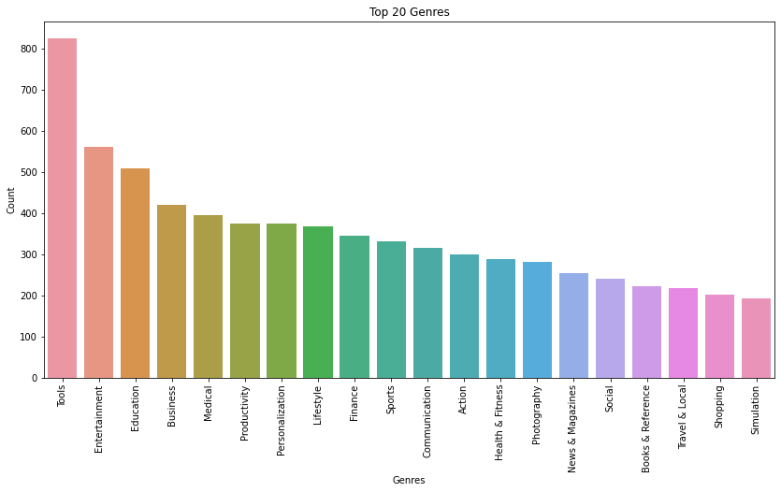
Data Visualization: We Analyzed the data and found the top 20 Applications as per their genres By considering the graph below Tools, Entertainment and Education were the most installed apps.

Slide 13
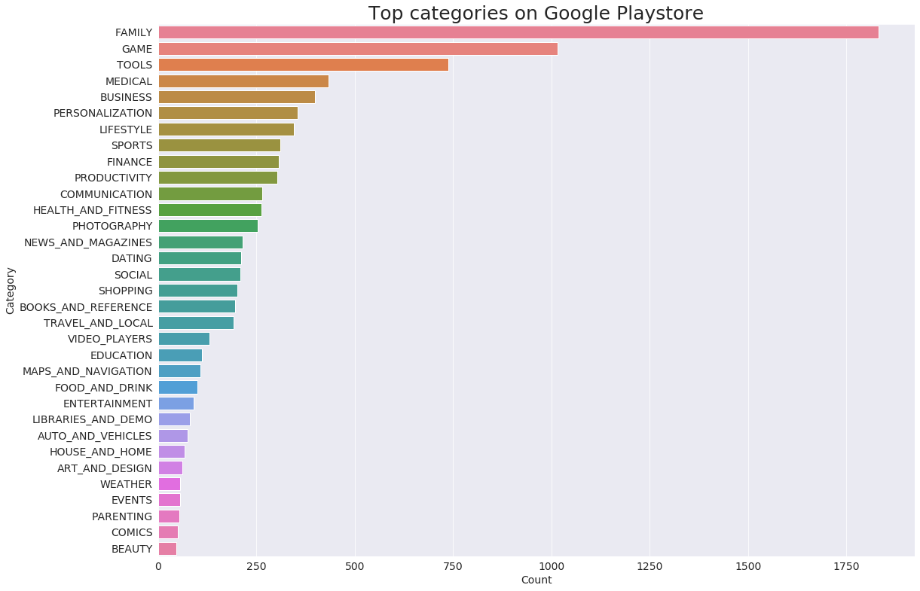

Slide 14
From the above two plots we can conclude that, maximum number of apps present in google play store comes under Family, Games and Tools Category but as per the installations and requirements in the market place, this is not the case. Maximum installed apps comes under Games, Communication and Tools.

Slide 15
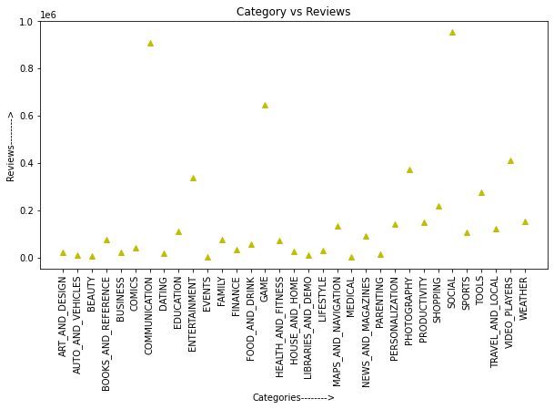
CATEGORY VS REVIEWS

Slide 16
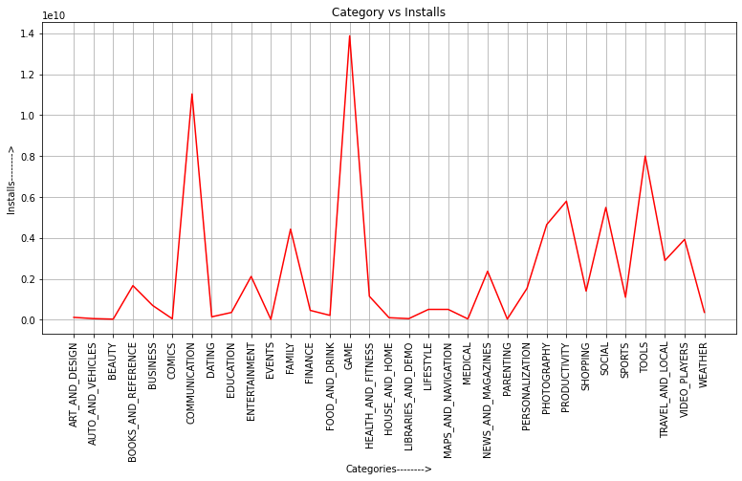
CATEGORY VS INSTALLS

Slide 17
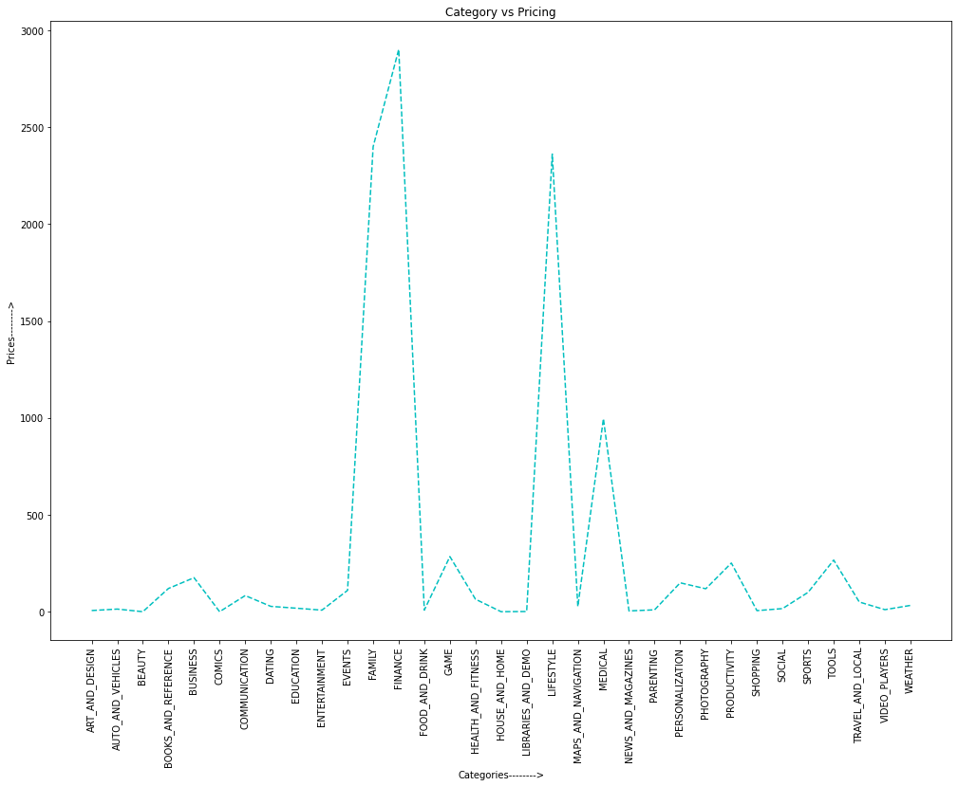
CATEGORY VS PRICING

Slide 18
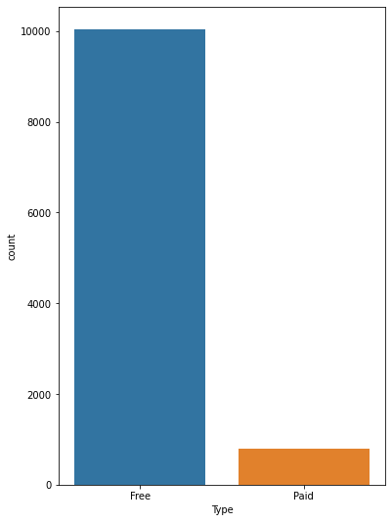
PAID VS FREE APPS
•Here we see what is the percentage off free app and paid app in play store.

Slide 19
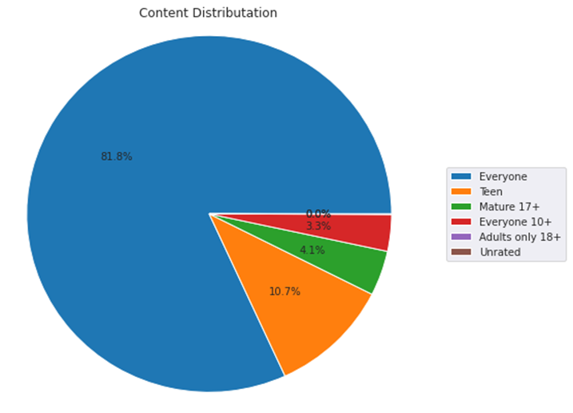
CONTENT VISUALIZATION
•Here the graph show different type content , it show the app is applicable for which category people.
•Almost 82% app is for everyone and in next 10.7% for teen.

Slide 20
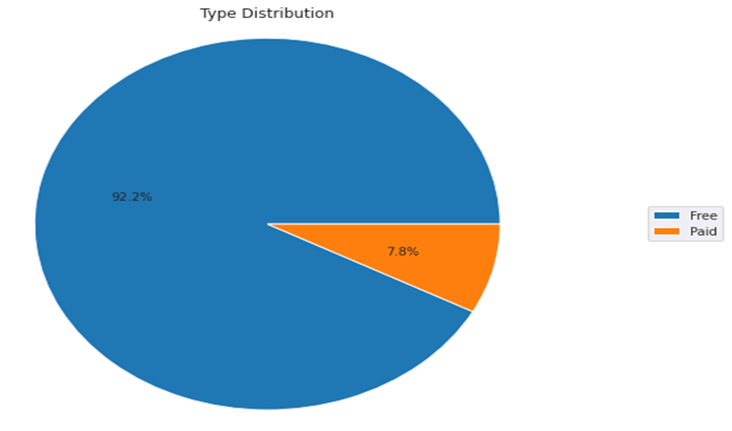
PAID VS FREE APP
•Here we see what is the percentage off free app and paid app in play store.
•Here we see from all app 92.2% app are free app and only 7.8% app are paid app.

Slide 21
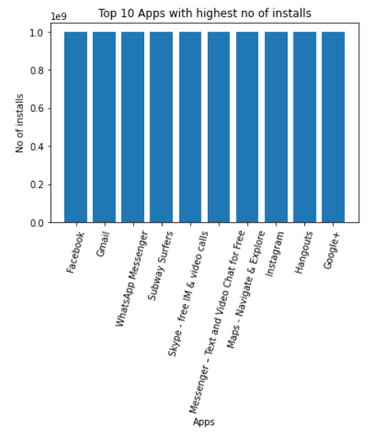
Top 10 Apps with highest no of installs

Slide 22
Top 10 Apps with highest number of reviews
APP | Reviews
Facebook | 78158306
WhatsApp Messenger | 69119316
Instagram | 66577313
Messenger – Text and Video Chat for Free | 56642847
Clash of Clans | 44891723
Clean Master- Space Cleaner & Antivirus | 42916526
Subway Surfers | 27722264
YouTube | 25655305
Security Master - Antivirus, VPN, AppLock, Booster | 24900999
Clash Royale | 23133508

Slide 23
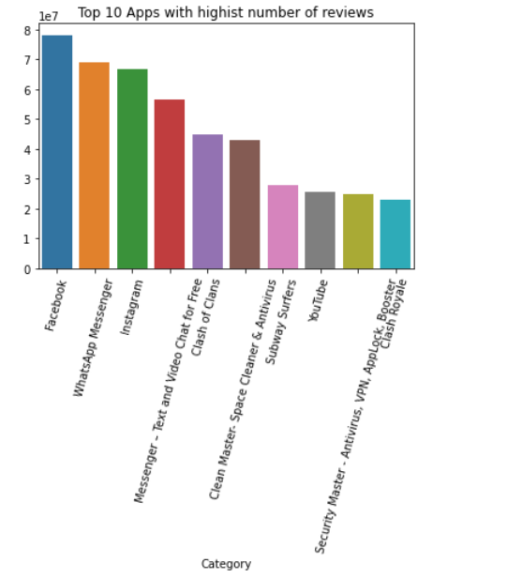
Facebook, WhatsApp and instagram have highest number of Reviews in google play store.

Slide 24
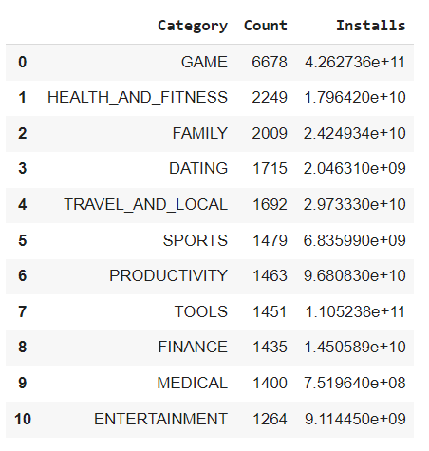
Facebook,Whatsaap and Instagram are having the highest number of reviews in google play store.Below are the top 10 categories having the highest number of installs?
In

Slide 25
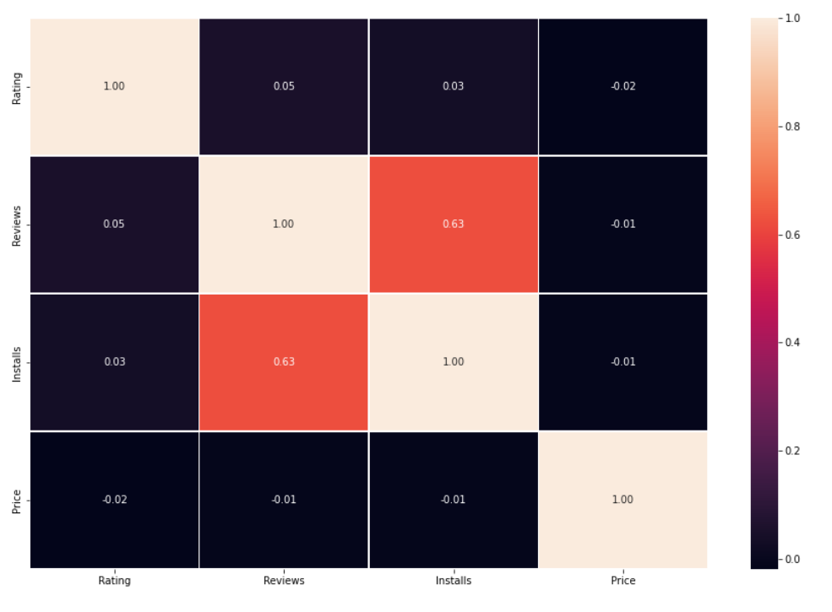
Installs and Reviews are Positively Correlated.

Slide 26
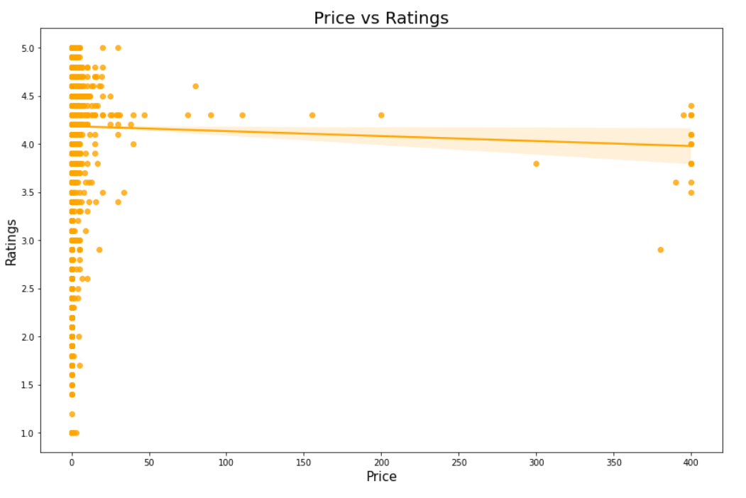
Generally increasing the Prices doesn't have significant effect on Higher Rating. For Higher Price, Rating is High. .

Slide 27
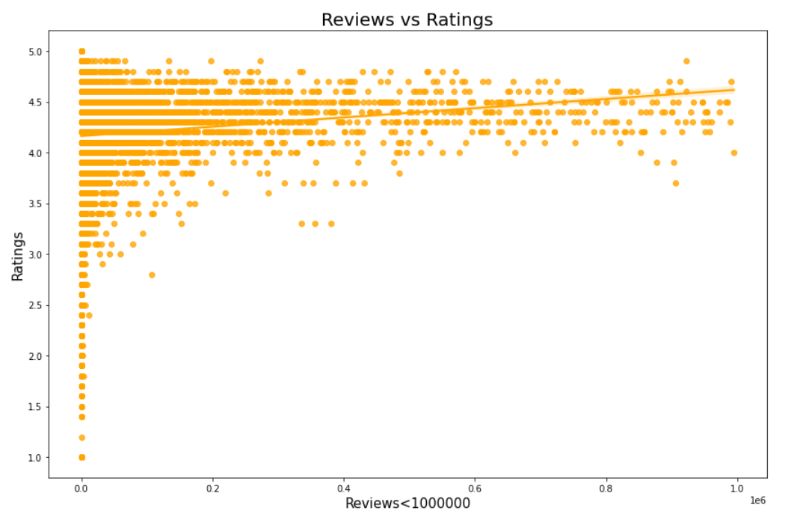
As per the below scatter plot with the trendline we can conclude that lesser reviews on applications will decrease the rating as well.

Slide 28
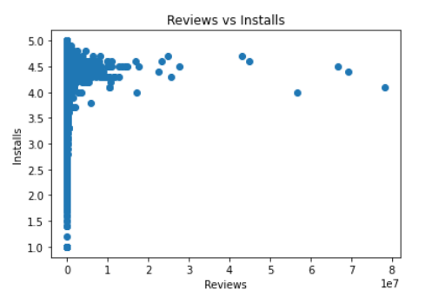
Reviews vs Installs

Slide 29
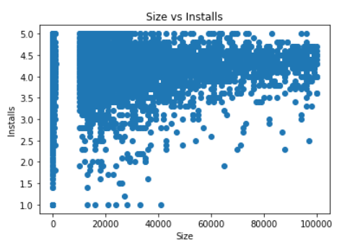
Size vs Installs

Slide 30
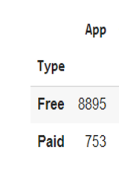
Here we can see that 92.22% apps are free and 7.78% are paid apps on Google Play Store, so we can say that Most of the apps are free on Google Play Store. Free vs Paid Apps

Slide 31
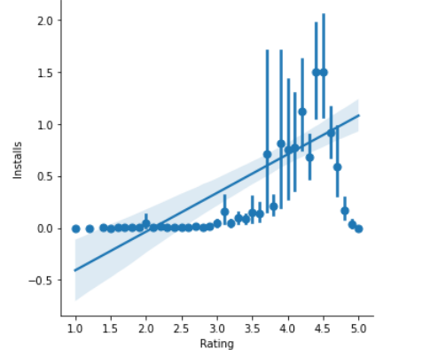
Installs vs Ratings Graph confirms that the apps with highest number of installs have the highest number of Ratings.

Slide 32
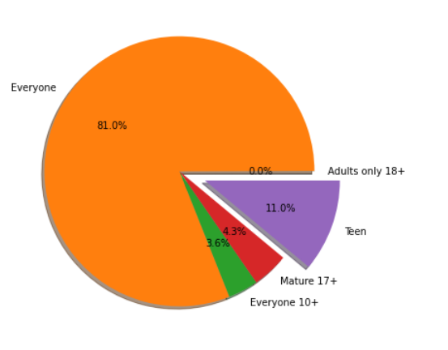
Number of installed Applications as per the content Rating. From the above pie plot we can say that 81% Apps can be accessed by everyone

Slide 33
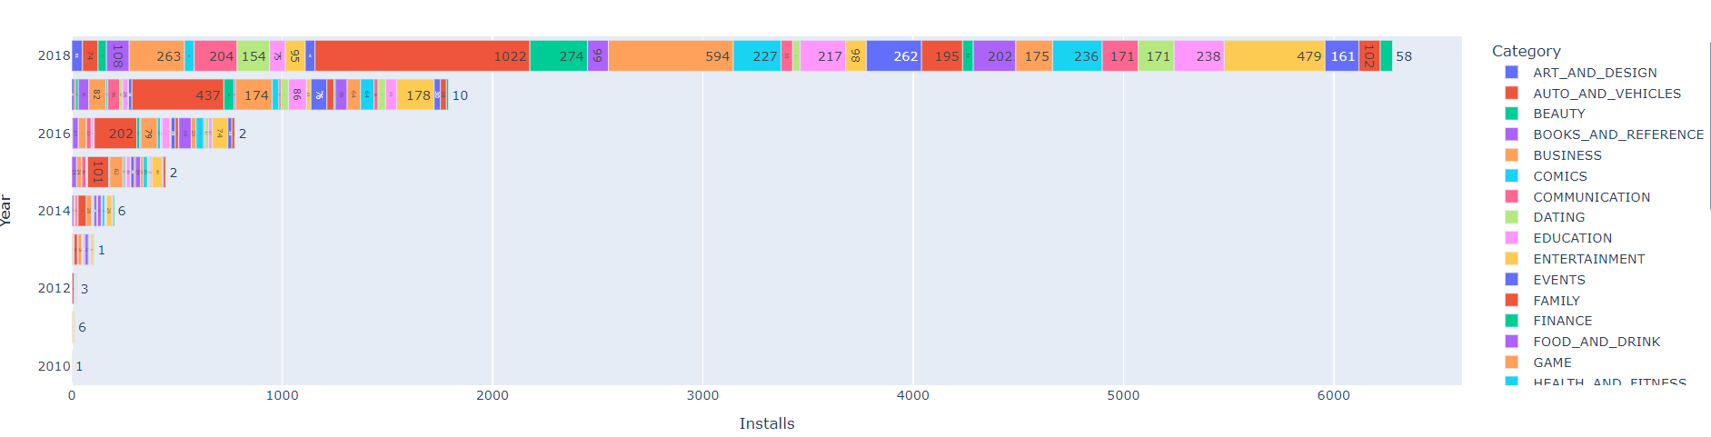
Most Downloaded apps in Play Store Dataset. Family Category has high number of Applications , moving from one year to another we can also see the change in number of apps.

